Slide 1

Modelling Passive Daytime Radiative Cooling Devices (PDRCs) using COMSOL Multiphysics™.
Student: Collins Munene Kariuki
Advisor: Professor Janice Hudgings

Slide 2
01
02
Motivation and Definitions
Theory and Methods
03
04
Results
Conclusions

Slide 3

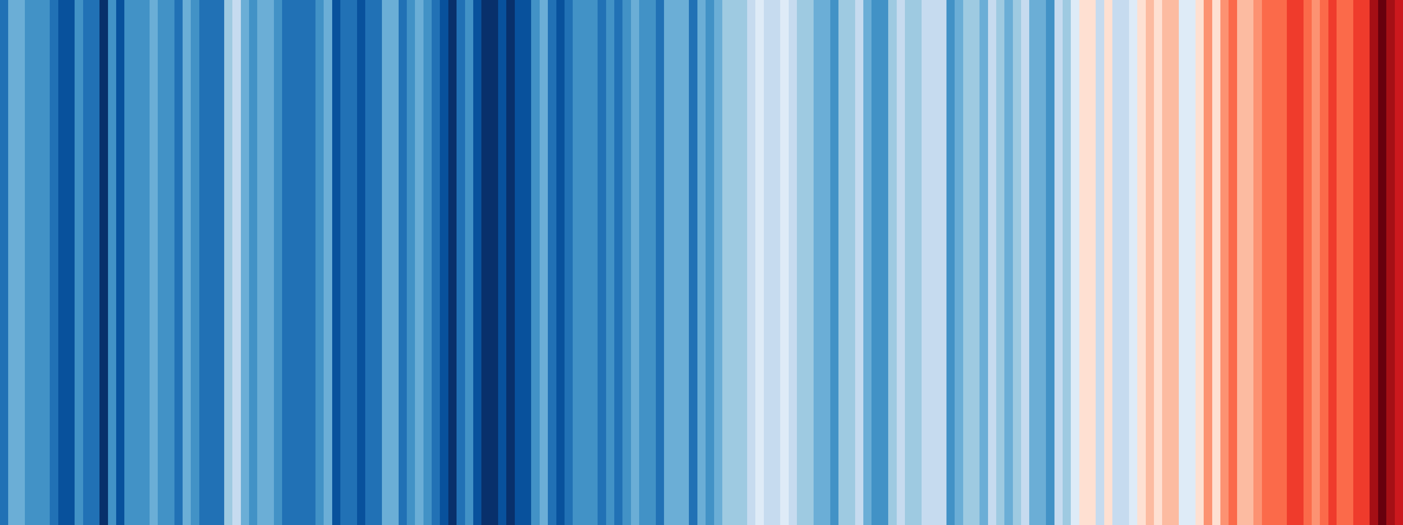
01
Motivation and Definitions

Slide 4

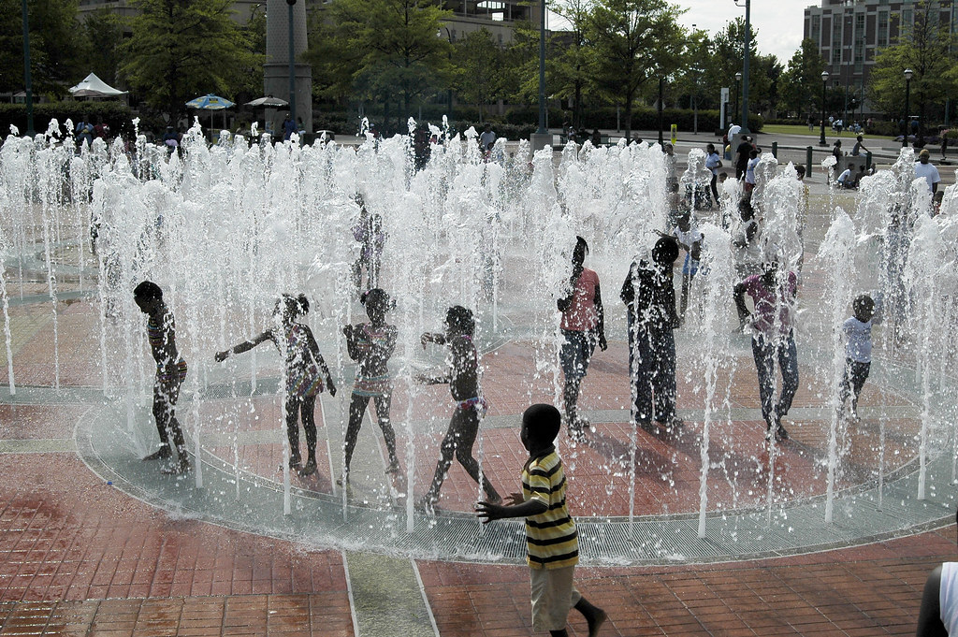
Cooling is Critical
Cooling has become more critical to humans due to global warming, rapid population growth, industrial development

Slide 5

Cooling is Critical
Global Warming: Rising air temperatures are a major factor influencing the need for cooling, as does humidity. High humidity makes cooling more necessary for comfort even at moderate temperatures. Climate change will significantly increase the global demand for space cooling.

Slide 6
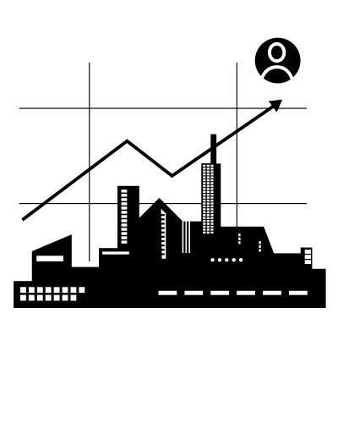
Cooling is Critical
Rapid Population Growth: Cities tend to have higher cooling needs due to higher population densities, lower evaporation due to less vegetation, and the “heat island effect” from buildings where there’s a feedback loop such that ACs release hot air outside and the higher temperatures lead to more AC use further increasing temperatures and so on.

Slide 7
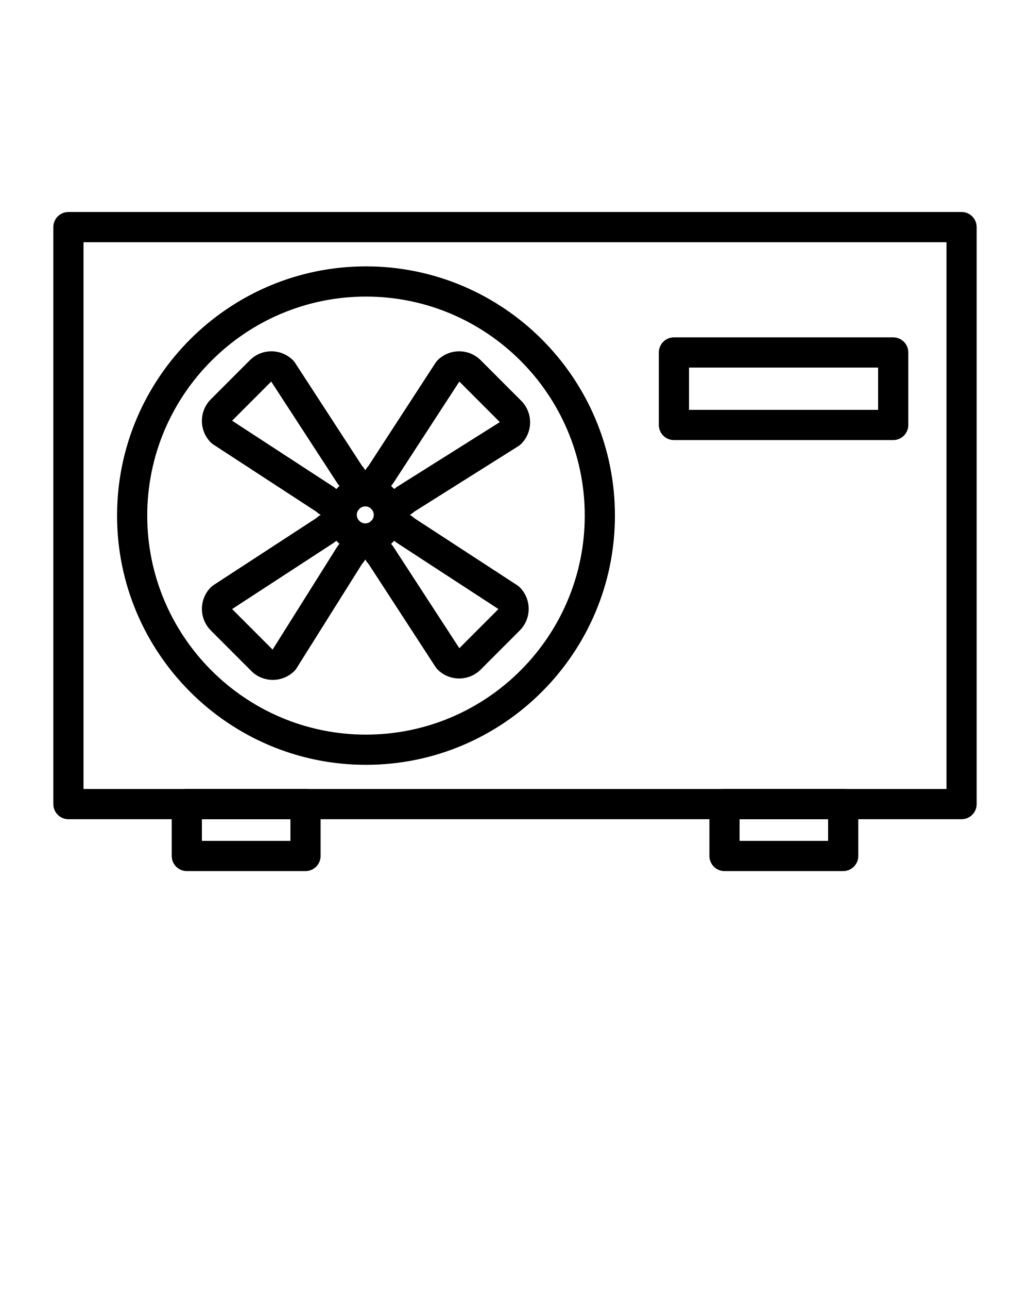
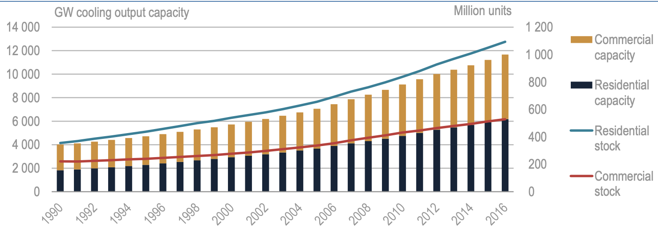
Heating, Ventilation, and Air Conditioning
AC sales have been steadily increasing, quadrupling between 1990 and 2016 (135 million units sold in 2016).
Worldwide stock and capacity of ACs by sector.
Key message: Sales of ACs, particularly to households, continue to grow briskly, pushing up the total
stock of units and global cooling capacity.

Slide 8

Heating, Ventilation, and Air Conditioning
The global installed AC capacity reached 11,675 GW by 2016, up from 4,000 GW in 1990.
The US has the most installed AC capacity globally.
Worldwide stock and capacity of ACs by sector.
Key message: Sales of ACs, particularly to households, continue to grow briskly, pushing up the total
stock of units and global cooling capacity.
Notes:
Japan, the US, South Korea, and China have the highest per capita AC sales though the rate is quickly rising in other countries, especially in Asia.

Slide 9

The Cooling Problem
Power grid strain: Peak cooling demand during heatwaves puts a strain on power grids, risking outages. In fact, in some regions, AC can account for over 70% of peak residential electricity demand.

Slide 10

The Cooling Problem
Greenhouse Gases (GHGs): ACs don’t directly emit GHGs, but leaks and improper disposal of refrigerants contribute to climate change. In 2016, space cooling caused an estimated 1,130 million tons of CO2 emissions.

Slide 11
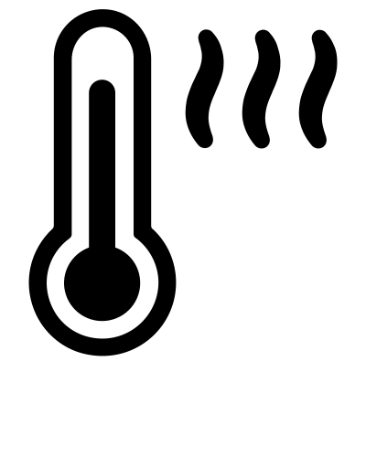
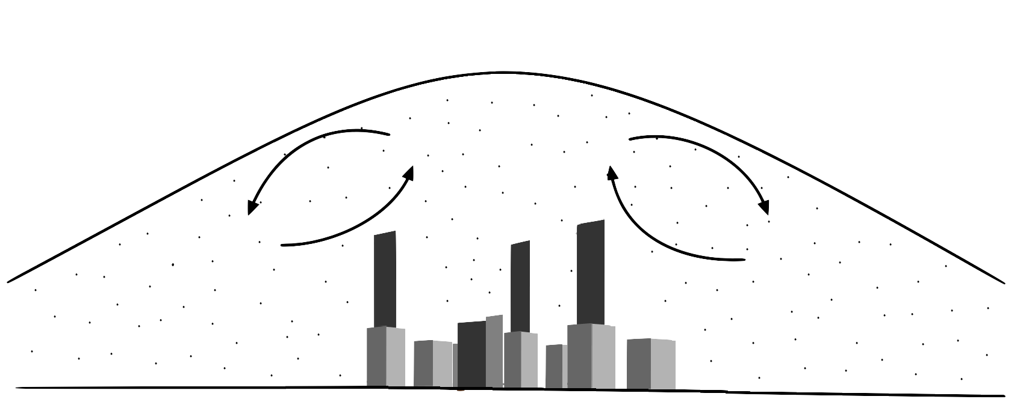
The Cooling Problem
“Heat Islands”: Urban areas that experience significantly higher temperatures. ACs release hot air outside, adding to the ambient heat, which necessitates the increased use of ACs. This increased heat can worsen air quality and smog formation.

Slide 12

Radiative Cooling: A Potential Solution?
Objects emit thermal radiation based on their temperature (governed by Planck’s Law).
Radiative cooling leverages this principle for passive cooling (without using electricity).

Slide 13

Radiative Cooling: A Potential Solution?
It works by emitting more radiation (especially infrared) than what’s absorbed by the object resulting in a temperature reduction below the ambient level.
The excess heat is transferred to our space due to the vast temperature difference of the earth and space.

Slide 14
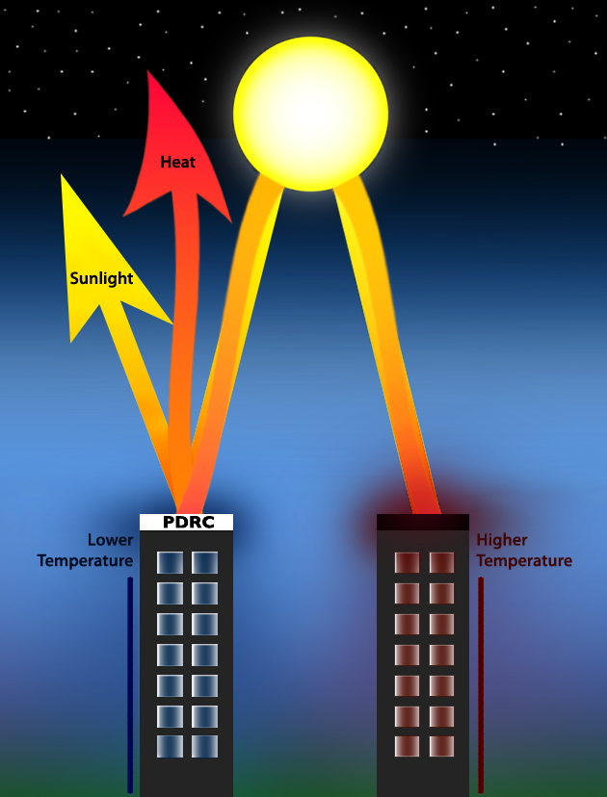
Radiative Cooling: A Potential Solution?
Achieves cooling by radiative heat to the “cold reservoir” of deep space (~3K).
This eliminates the need for energy consuming methods like conventional AC.

Slide 15
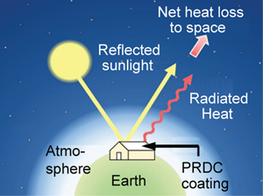
Important Criteria for Radiative Cooling
Passive radiative cooling can be realized even during the daytime, necessitating precise tuning of optical properties across a broad spectrum of wavelengths.
Achieving effective passive daytime radiative cooling imposes stringent requirements and structures to mitigate solar heating:

Slide 16
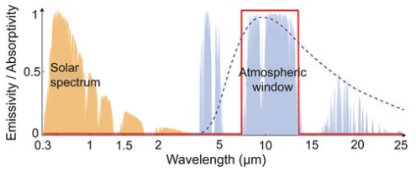
Important Criteria for Radiative Cooling
1. Minimal absorptivity approaching 0% (equivalent to nearly 100% reflectance) in the solar spectrum, ranging from 0.3-2.5 micrometers. This characteristic ensures that the surface absorbs minimal solar energy during daylight, thereby reducing the heat gained by the PDRC.
Spectral Characteristics of Ideal Passive Daytime Radiative Cooling (PDRC) Materials
Key Message: The ideal PDRC material exhibits low absorptivity within the solar spectrum for energy absorption, while also having high emissivity within the atmospheric window to maximize thermal radiation escape, contributing to effective cooling during daytime.

Slide 17
Important Criteria for Radiative Cooling
2. High thermal radiation in the atmospheric transparency window, with an emittance close to 1 within the long-wavelength infrared (LWIR) transmission window of the atmosphere (8–13 micrometers). This range is significant due to the atmosphere's partial transparency and minimal infrared absorption by gas molecules in this spectrum.
Spectral Characteristics of Ideal Passive Daytime Radiative Cooling (PDRC) Materials
Key Message: The ideal PDRC material exhibits low absorptivity within the solar spectrum for energy absorption, while also having high emissivity within the atmospheric window to maximize thermal radiation escape, contributing to effective cooling during daytime.

Slide 18
Important Criteria for Radiative Cooling
3. An emittance close to 0 in other mid-infrared wavelengths, such as 5–8 micrometer and those greater than 13 micrometer. This characteristic is crucial due to the atmosphere's opacity in these spectral ranges.
Spectral Characteristics of Ideal Passive Daytime Radiative Cooling (PDRC) Materials
Key Message: The ideal PDRC material exhibits low absorptivity within the solar spectrum for energy absorption, while also having high emissivity within the atmospheric window to maximize thermal radiation escape, contributing to effective cooling during daytime.

Slide 19
Previous Project Work and Project Goals
Research on PDRCs has been an ongoing project in the Hudgings lab. This thesis aims to build upon the work of Paul McKinley (class of 2022) and Genevieve diBari (class of 2023).

Slide 20
Previous Project Work and Project Goals
McKinley laid the groundwork by developing a rooftop testbed and the fabrication process for PDRCs (a process I plan to replicate after completing the modeling of various PDRC iterations on COMSOL). DiBari contributed by modeling PDRCs in Python and enhancing the initial outdoor testing setup.

Slide 21
Previous Project Work and Project Goals
For my thesis, the goal is to:
- Acquaint myself first with the COMSOL suite.
- Model different PDRC structures using COMSOL, exploring materials that could enhance the optical properties of an ideal PDRC device.
This might include stacking materials of varying thicknesses and refractive indices on current PDRC models in the Hudgings lab to increase reflectivity (R).

Slide 22
01
PHYSICS BEHIND PDRCs, Briefly

Slide 23
Preliminaries
A PDRC operates by absorbing a lower amount of radiation than it emits, thereby facilitating electricity-free cooling, even in daylight conditions.

Slide 24
Preliminaries
Thus, one of the pivotal attributes of a PDRC device is the imperative for an absorptivity as close to 0% or likewise reflectance to as close as 100% within the solar spectrum.

Slide 25
Preliminaries
Emissivity in the Atmospheric Window: Needs to be near 100% with 8-13 µm range with reflectivity close to 0% to minimize earth-emitted radiation absorption.

Slide 26
Preliminaries
To aid us in determining the reflectance values are what we call the Fresnel Equations. These equations describe the reflection and transmission of electromagnetic waves at material interfaces, aiding in designing PDRC devices with layers of varying reflective properties and refractive indices.

Slide 27
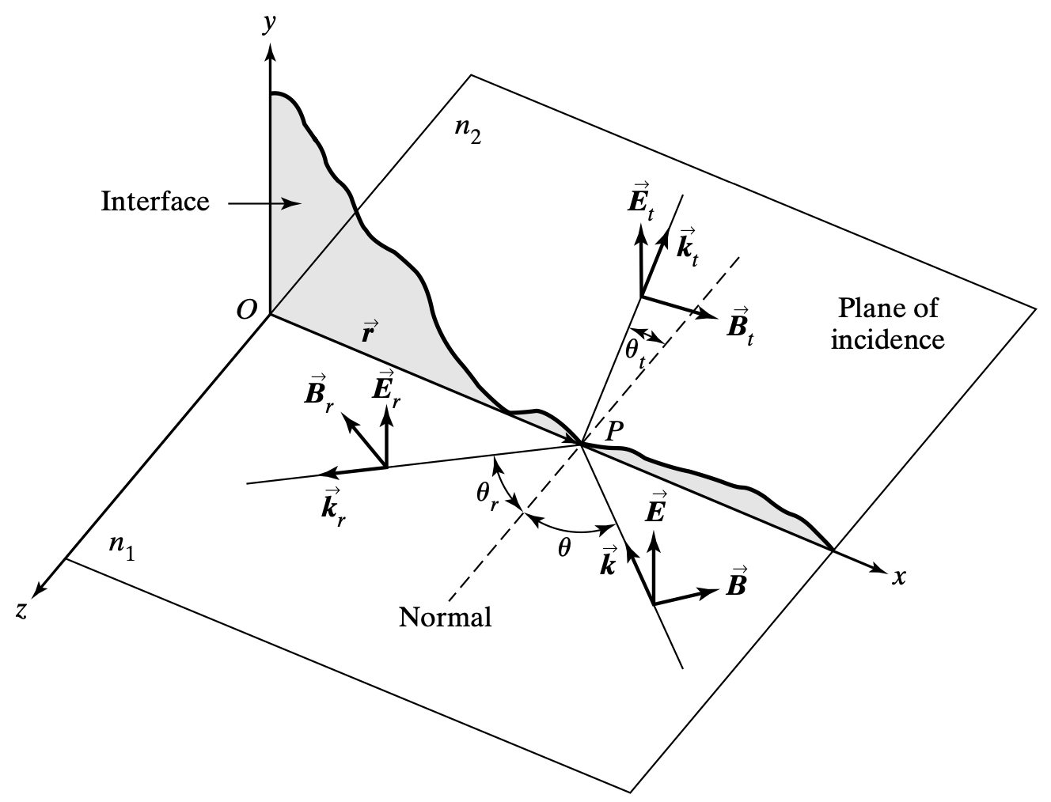
Fresnel Equations
A light ray hits a planar interface at point P, creating reflected and refracted rays.

Slide 28
Fresnel Equations
The respective refractive indices for the medium are the material properties that dictate light’s behavior before and after the interface.

Slide 29
Fresnel Equations
The plane of incidence, here, is defined within the x-z plane by the surface normal and incident ray’s direction, crucial for understanding light’s behavior at interfaces.

Slide 30
Fresnel Equations
We can investigate the Fresnel Equations in the context of the 2 types of linear polarizations of light, for simplicity:
Transverse electric polarization.
Transverse magnetic polarization.

Slide 31
Fresnel Equations
To determine the reflectance, R, and consequently, the transmittance, T, it’s imperative to define the reflection (r) and transmission (t) coefficients:
r = E_r/E and t = E_t/E

Slide 32
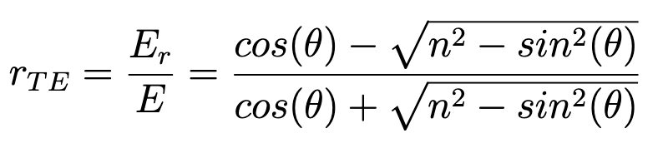
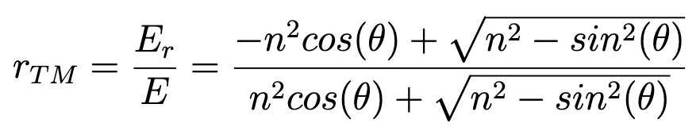
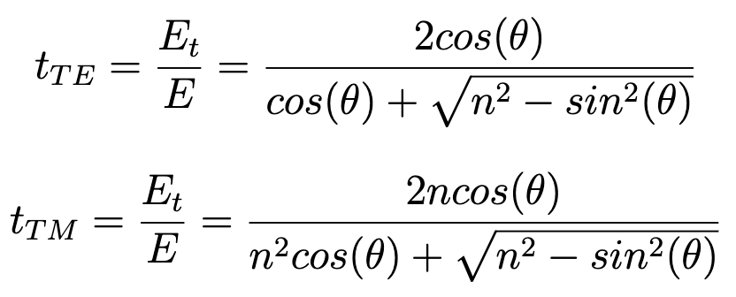
Fresnel Equations
These Fresnel Equations connect incident and reflected energy field amplitudes in linear, isotropic, homogeneous media. They enable the determination of reflectance, R, and transmittance, T, for analyzing light’s interaction with materials.

Slide 33
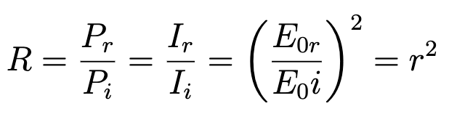
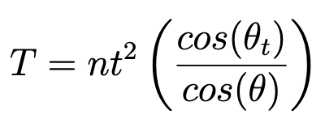
Fresnel Equations
Invoking energy conservation, boundary conditions, and that R+T=1, we find that:

Slide 34
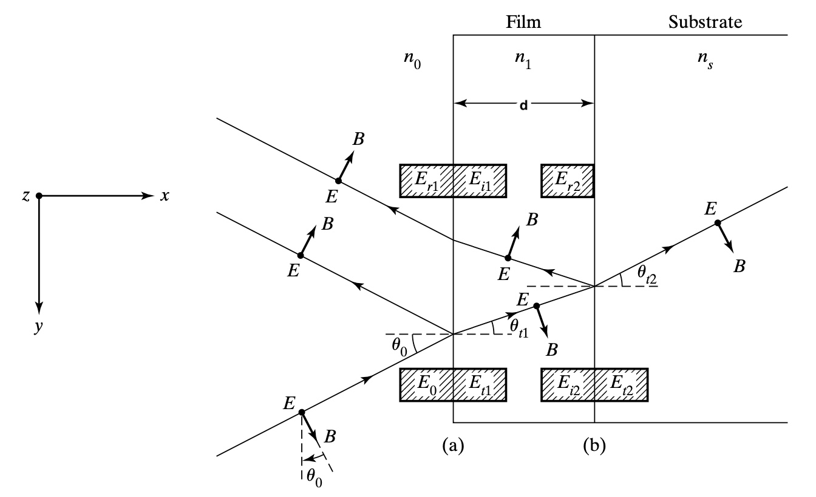
Multilayer Films
At the heart of analyzing how EM waves interact with thin-film structures lies a powerful tool called the transfer matrix.
This 2-by-2 matrix is essential in analyzing how EM waves interact with multiple layers of thin-film structures.

Slide 35
Multilayer Films
The transfer matrix links electric and magnetic fields predicting wave behavior across multilayer stacks.
Useful for both single and multiple interfaces, facilitating scalable analysis of layer dynamics.

Slide 36
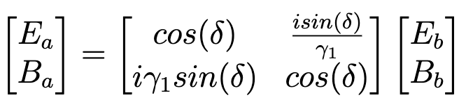
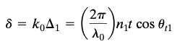
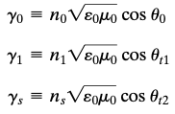
Multilayer Films
Involves complex transmission and reflection interactions at air-film and film-substrate boundaries.

Slide 37
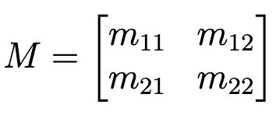
Multilayer Films
The thickness of the film should be comparable to light’s wavelength as the thickness plays a role in creating the interference patterns.

Slide 38
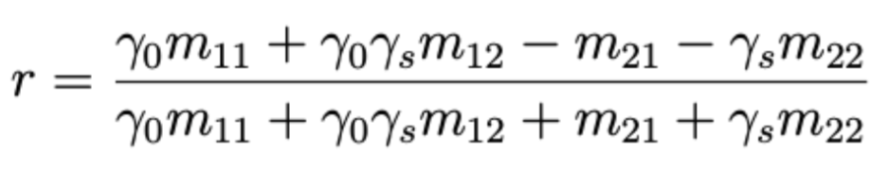
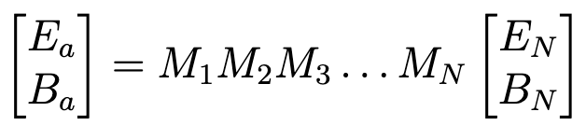
Multilayer Films
Expanding this framework, we can extend the consideration to the stacking of multiple films, leading to the emergence of multiple interfaces. In a more general context, for an arbitrary number N of layers:
Using the fact that r = E_r1/E_0, we get:

Slide 39
Multilayer Films
Using the fact that r = E_r1/E_0, we get:

Slide 40
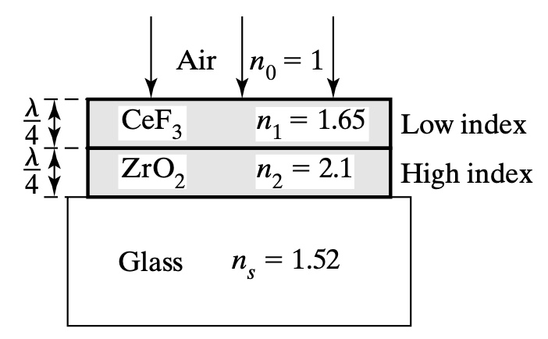
Antireflecting Films
To gain deeper insights into optimizing reflectance, let’s explore the characteristics conducive for anti-reflection, first:
Recall our transfer matrix looked like:

Slide 41
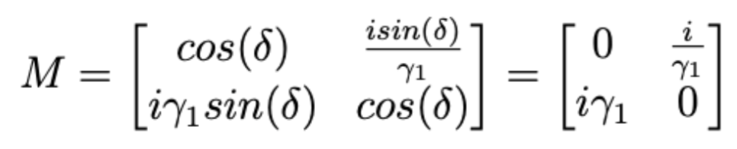
Antireflecting Films
At normal incidence (theta = 0) and for a film of quarter-wave thickness, the phase difference becomes pi/2, so that cos(delta)=0 and sin(delta)=0.
The transfer matrix becomes:

Slide 42
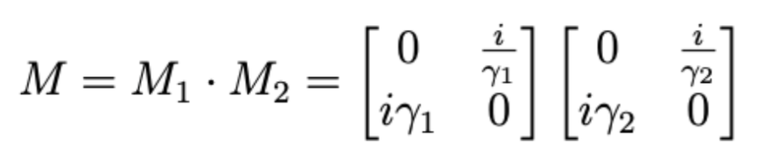
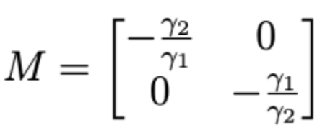
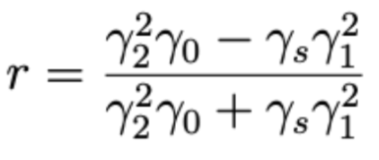
Antireflecting Films
The overall transfer matrix for the system is then the product of the transfer matrix due to the first interface and the transfer matrix of the second interface:
Recall that the reflection coefficient is generally defined as:
Which can then be evaluated to:

Slide 43
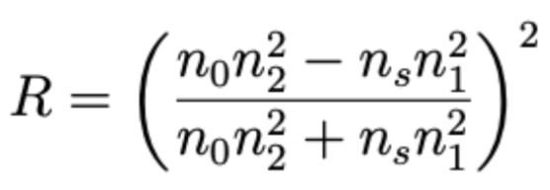
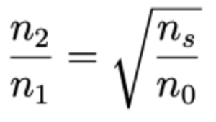
Antireflecting Films
The reflectance, R, is simply |r|^2. Using our calculated R for this double quarter-wavelength layer, we find R to be:
Zero reflectance is expected when the numerator is zero, thus when:
For a glass substrate with a refractive index of n_s=1.52 and incidence from air with n_0=1, the optimal ratio of the refractive indices for the 2 films should be sqrt(1.52)~1.23

Slide 44
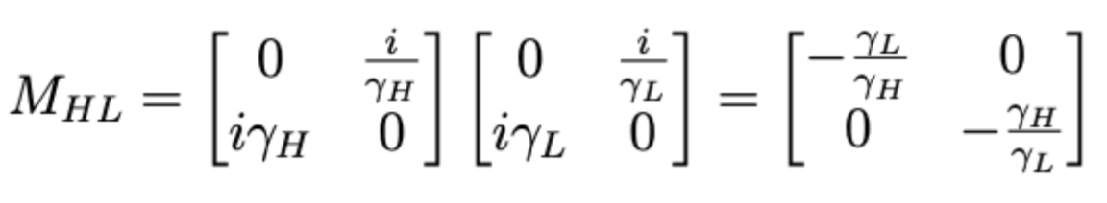
High-Reflectance Layers
We have realized that to optimize for anti-reflectance, we stack layers in the order of air-low index-high index-substrate. Conversely, to optimize for high-reflectance, we follow the opposite order: air-high index-low index-substrate.
The transfer matrix for the 2 films in the order high index-low index is:

Slide 45
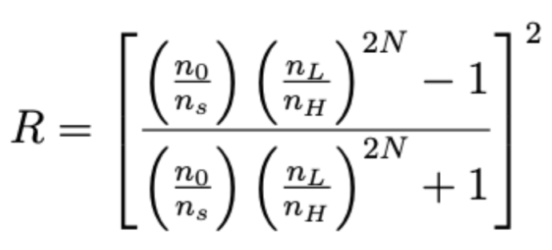
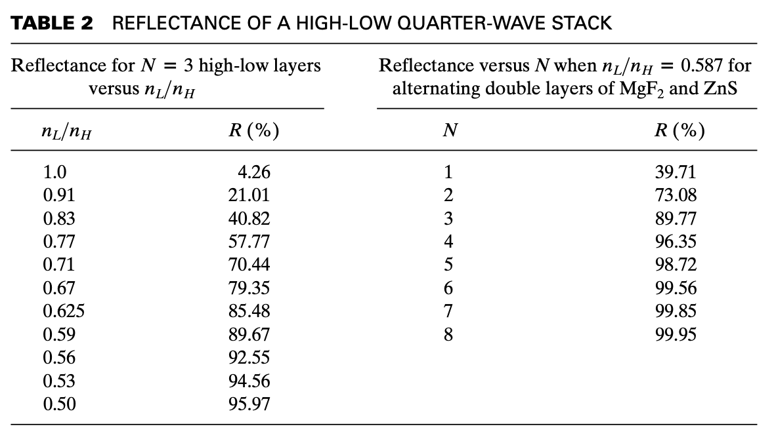
High-Reflectance Layers
Considering normal incidence, we find R to be
As close to maximum 100% reflectance can either be achieved:
When N (the number of layer pairs) approaches infinity.
When n_L/n_H approached zero.

Slide 46
COMSOL Multiphysics
COMSOL Multiphysics TM is a comprehensive software suite for finite element analysis, solving, and simulation across a wide array of physics and engineering disciplines, particularly focusing on coupled phenomena and multi-physics interactions.

Slide 47
COMSOL Multiphysics
COMSOL software supports a broad spectrum of applications, from electromagnetics and structural mechanics to acoustics, fluid dynamics, heat transfer, and chemical engineering.

Slide 48
COMSOL Multiphysics
For my thesis, which involves analyzing ray paths in optical systems, I will be utilizing the Ray Optics module.

Slide 49
COMSOL: The Modeling Workflow
Briefly, the modelling workflow consists of the following steps, if you start the model completely from scratch:
Initialization of the modelling environment
Geometry construction
Material property specification
Physics boundary conditions
Mesh generation
Simulation execution
Results post-processing

Slide 50
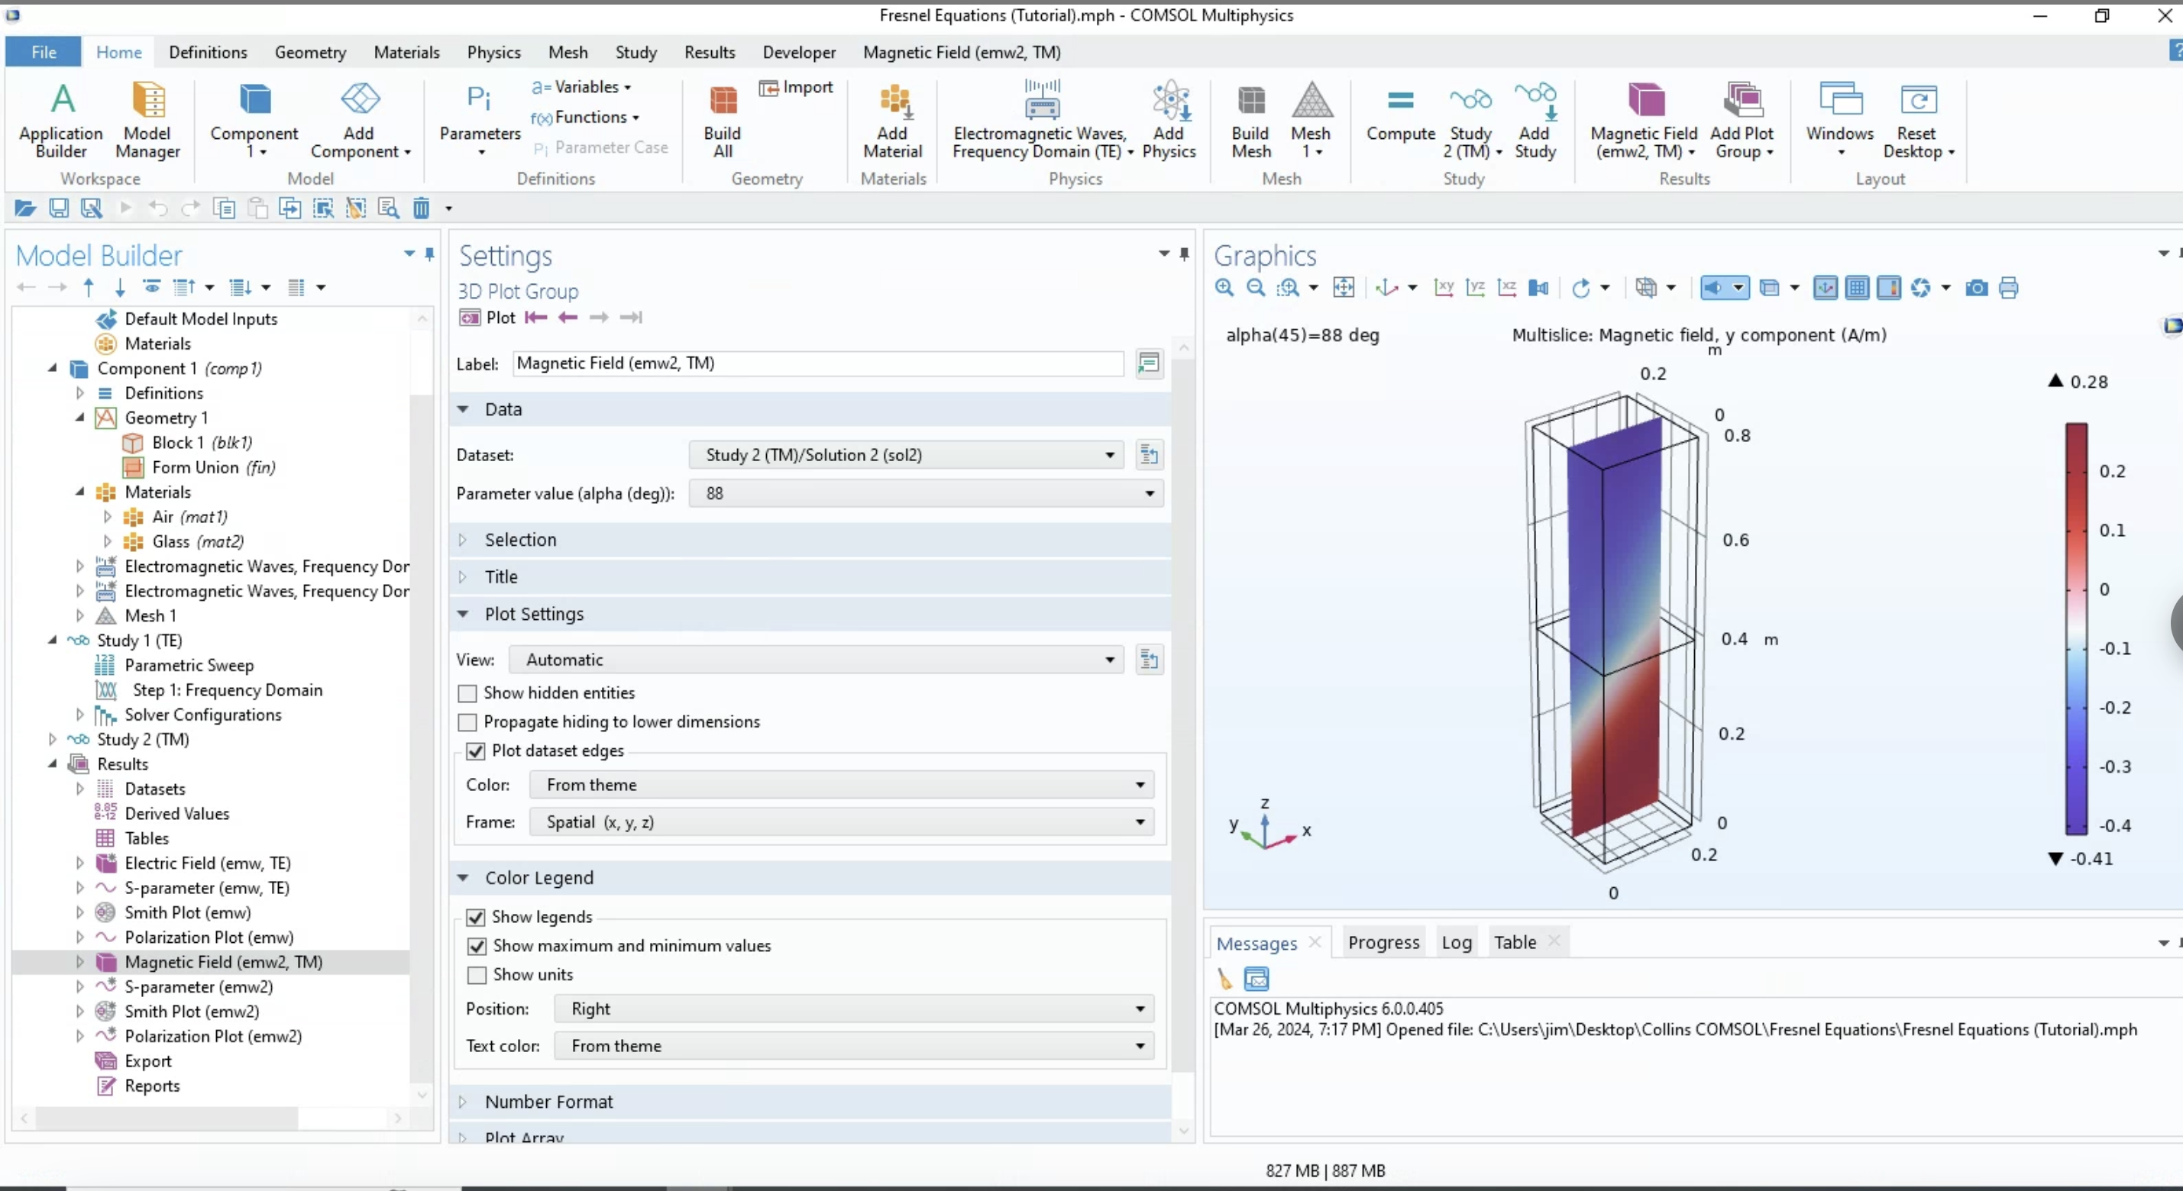

Slide 51
COMSOL: Modeling Anti-reflectivity.
As we saw before for antireflecting double quarter-wavelength films, assuming normal incidence, we get:

Slide 52
COMSOL: Modeling Anti-reflectivity.
To achieve as low reflectivity as possible, we need to choose 2 materials such that,
For a glass substrate with a refractive index of n_s = 1.52 and incidence from air with n_0 = 1, the optimal ratio of the refractive indices for the 2 films should be sqrt(1.52) ~ 1.23

Slide 53
COMSOL: Modeling Anti-reflectivity.
To accurately emulate this, I selected n_2=1.63 and n_1=1.38, resulting in an n_2/n_1 ratio approximately equal to 1.23, specifically 1.18.

Slide 54
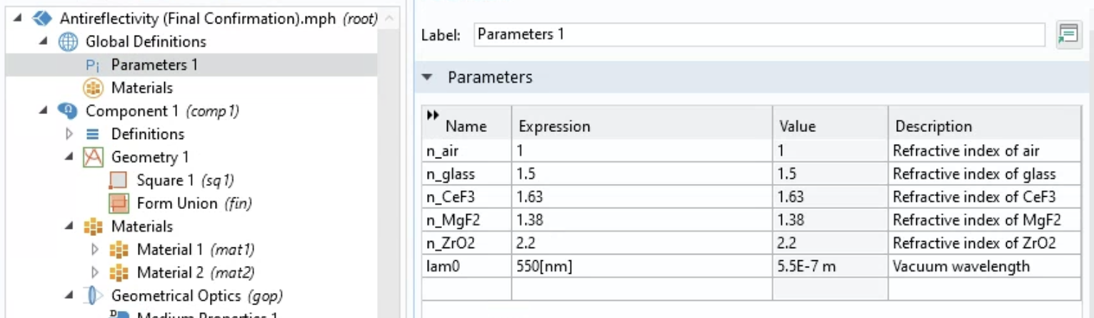
COMSOL: Modeling Anti-reflectivity.
Initialization of the modelling environment

Slide 55
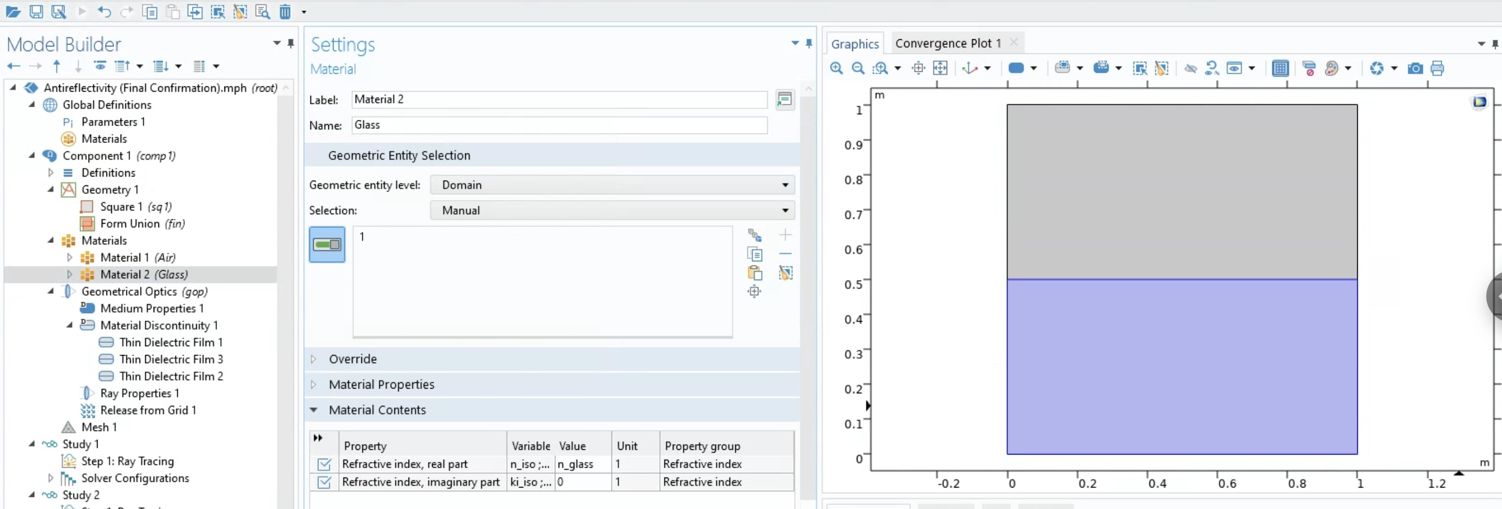
COMSOL: Modeling Anti-reflectivity.
Geometry construction

Slide 56
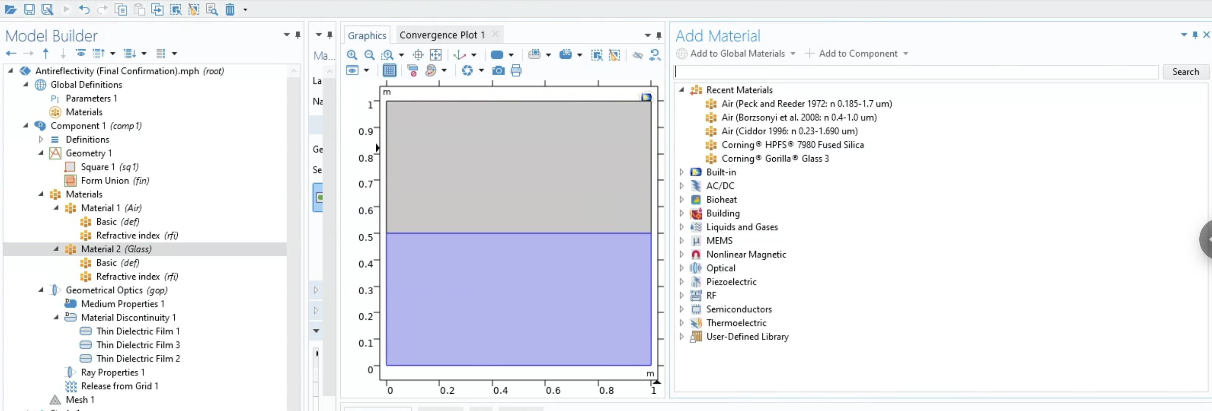
COMSOL: Modeling Anti-reflectivity.
Material property specification

Slide 57
COMSOL: Modeling Anti-reflectivity.
Physics boundary conditions
Employ materials like magnesium fluoride (MgF2) for the first layer and cerium fluoride (CeF3) for the second layer due to their specific refractive indices, which are closer to the optimal values required for reducing reflectance.

Slide 58
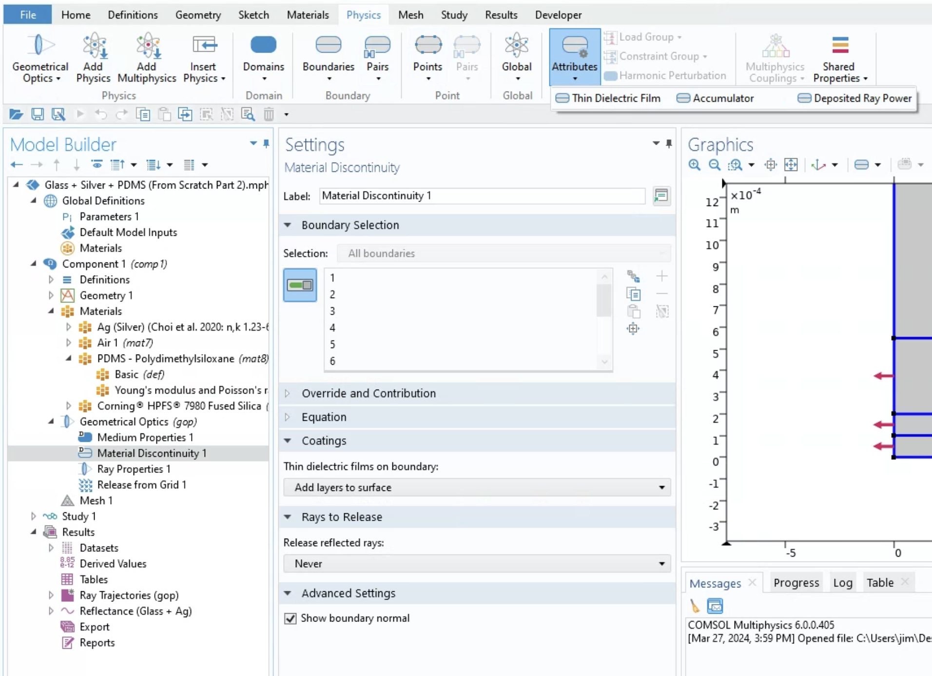
COMSOL: Modeling Anti-reflectivity.
Physics boundary conditions
To do this, one needs to model the 2 layers as thin-film dielectrics.

Slide 59
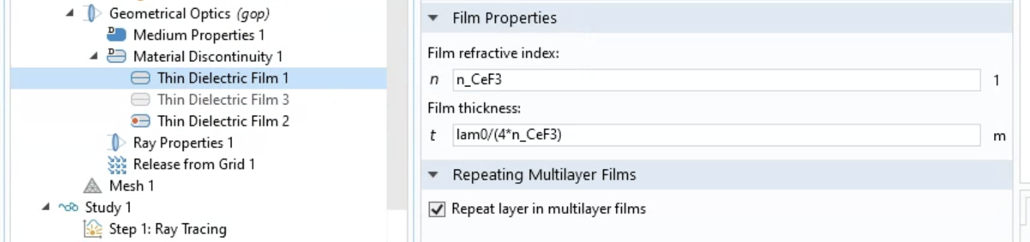
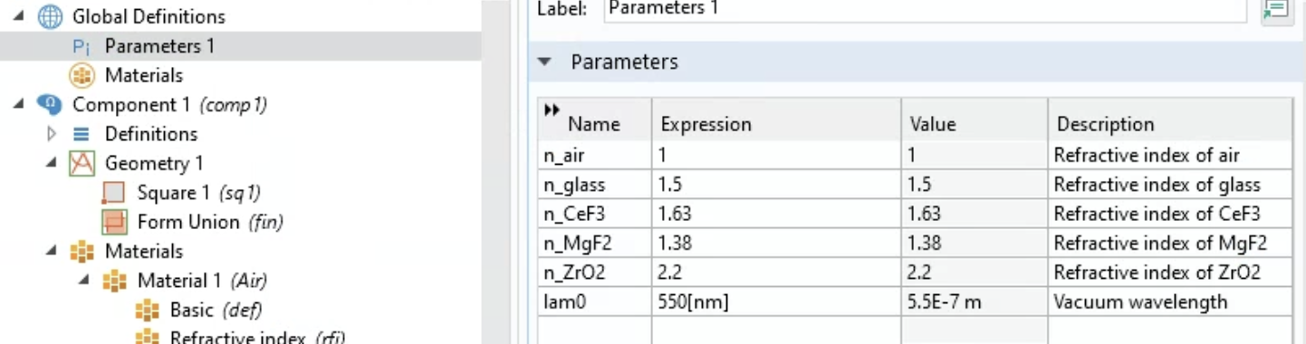
COMSOL: Modeling Anti-reflectivity.
Physics boundary conditions
n_2/n_1 = 1.63/1.38 = 1.18 which is close to sqrt(1.5/1) = 1.22

Slide 60
COMSOL: Modeling Anti-reflectivity.
Mesh generation
The mesh is a network of elements that subdivides the simulation domain into smaller pieces.
The mesh acts as the framework upon which the equations are solved, with the accuracy of the solution often depending on the quality and refinement of the mesh.

Slide 61
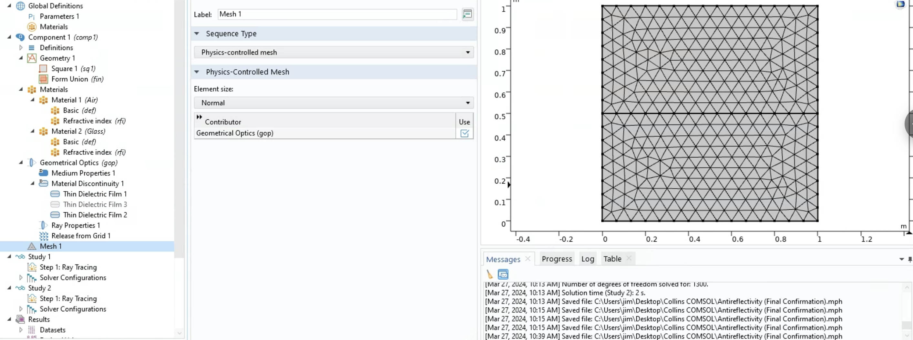
COMSOL: Modeling Anti-reflectivity.
Mesh generation
Opted for the default normal-sized mesh.

Slide 62
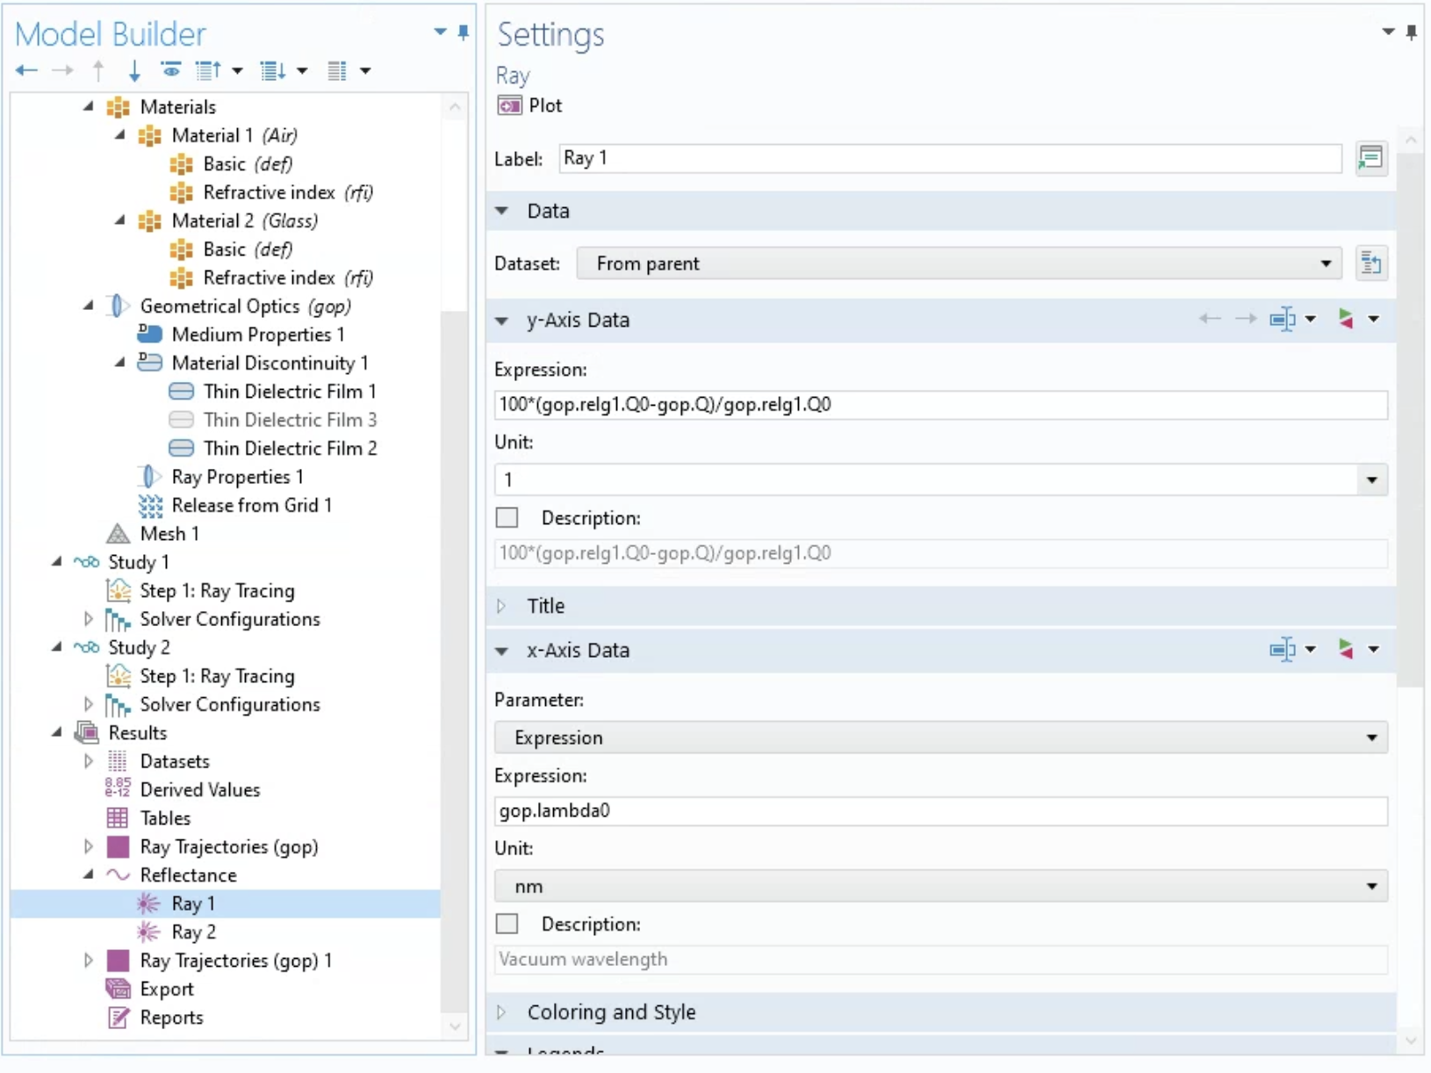
COMSOL: Modeling Anti-reflectivity.
Simulation execution
(gop.relg1.Q0 - gop.Q) / gop.relg1.Q0
gop.relg1.Q0: This represents the incident power at the first surface where the rays are released. Q0 indicates the initial power of the rays.
gop.Q: This is the power of the rays after they have interacted with the surface. In this context, it is the remaining power in the rays that are not reflected and can be either absorbed or transmitted.
(gop.relg1.Q0 - gop.Q) / gop.relg1.Q0: This fraction represents the ratio of the reflected power to the incident power. It's a measure of how much power is reflected compared to how much power was incident on the surface.
Notes:
The expression you've given is a formula used in COMSOL Multiphysics to calculate the percentage reflectance of a surface. Here's what each part of the expression represents:
- 100: This is a scaling factor that converts the fraction of the reflected power to a percentage. Since reflectance is the fraction of power reflected from the surface, multiplying by 100 gives you a percentage value.
- gop.relg1.Q0: This represents the incident power at the first surface where the rays are released. In COMSOL's Ray Optics Module, `gop` stands for Geometrical Optics physics interface, `relg1` refers to the first release feature of the rays, and `Q0` indicates the initial power of the rays.
- gop.Q: This is the power of the rays after they have interacted with the surface. In this context, it is the remaining power in the rays that are not reflected and can be either absorbed or transmitted.
- (gop.relg1.Q0 - gop.Q): This part of the expression calculates the difference between the initial power of the rays and the power after interaction with the surface. Essentially, this is the power that has been reflected.
- (gop.relg1.Q0 - gop.Q) / gop.relg1.Q0: This fraction represents the ratio of the reflected power to the incident power. It's a measure of how much power is reflected compared to how much power was incident on the surface.
- 100*(gop.relg1.Q0 - gop.Q) / gop.relg1.Q0: This final expression gives the percentage of the incident power that is reflected by the surface.
In summary, the formula calculates the percentage of the initially released power that is reflected by a surface within a COMSOL simulation. It's used to evaluate the effectiveness of surfaces in reflecting light, which is critical in applications like designing antireflective coatings or analyzing the reflective properties of materials.

Slide 63
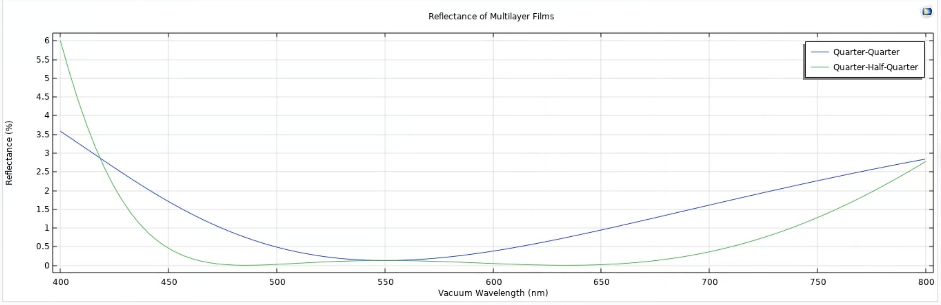
COMSOL: Modeling Anti-reflectivity.
Quarter-Quarter Coating: This configuration consists of two layers, each a quarter-wavelength thick. The ideal situation for such a coating is to have zero reflectance at a specific wavelength, but due to practical limitations of material properties, perfect zero reflectance is usually not achieved.

Slide 64
COMSOL: Modeling Anti-reflectivity.
Quarter-Half-Quarter Coating: Adding a third layer, a half-wavelength thick, between the two quarter-wavelength layers forms this configuration. This setup is designed to reduce reflectance over a broader range of wavelengths.

Slide 65
COMSOL: Modeling Anti-reflectivity.
In the graph, the quarter-quarter coating (blue line) achieves low reflectance near a single wavelength but reflects more at other wavelengths.
The quarter-half-quarter coating (green line) might have a slightly higher reflectance at its center wavelength, but overall, it maintains low reflectance across a much wider band of the spectrum.

Slide 66
COMSOL: Modeling Anti-reflectivity.
Practical Implication: Multi-layer coatings are more effective than single-layer ones for antireflective purposes, as they can address a range of wavelengths. This makes them suitable for various applications, where reducing glare and maximizing light transmission are crucial, such as in lenses and optical devices.

Slide 67
COMSOL: Modeling Anti-reflectivity.
By comparing these two coating strategies, the graph demonstrates the advantage of using multi-layer coatings for achieving efficient antireflective properties over a broader spectrum of light.

Slide 68
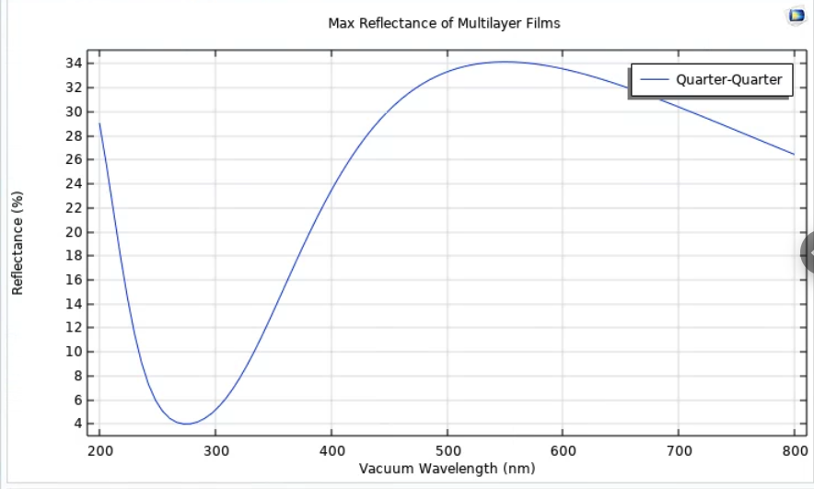
COMSOL: Modeling High Reflectance.
Basic Concept of High-Low Index Stack: In a high-low index stack, you have alternating layers of materials with high and low refractive indices. This specific configuration causes incident light waves to reflect multiple times within the stack.

Slide 69
COMSOL: Modeling High Reflectance.
Quarter-Quarter Wavelength Principle: Each layer in your double-layer film is a quarter wavelength thick at the design wavelength. This thickness is chosen so that the reflected light from the boundaries of each layer constructively interferes, resulting in a higher overall reflectance.

Slide 70
COMSOL: Modeling High Reflectance.
Design Wavelength: The wavelength, here 550 nm, where the reflectance is maximized. It is at this wavelength that constructive interference is optimal, resulting in the highest reflectance.

Slide 71
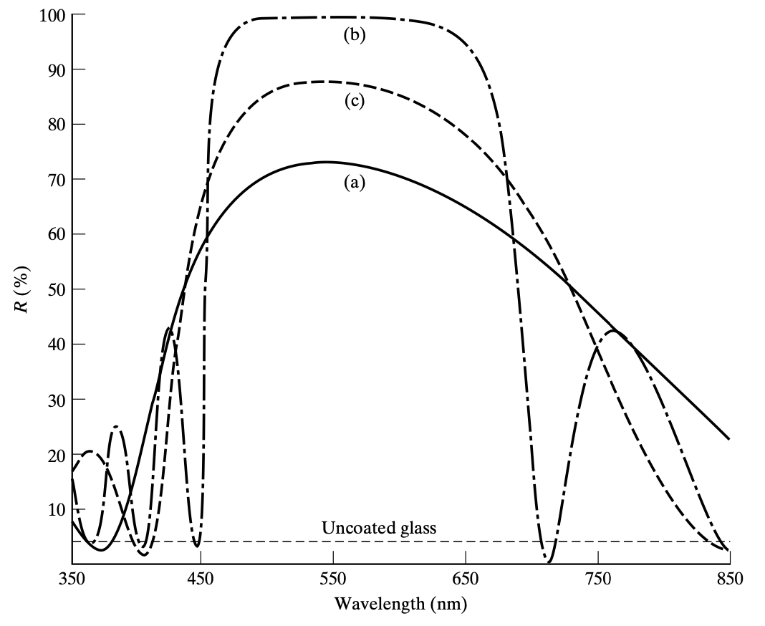
COMSOL: Modeling High Reflectance.
Stopband: The central region of high reflectance can be tuned to different wavelengths by changing the layer thickness, with the thicknesses being a quarter-wavelength at the design wavelength of 550 nm.

Slide 72
COMSOL: Modeling High Reflectance.
Design Application: Such high-reflectance stacks are also known as dielectric mirrors and can be tailored to specific wavelengths, making them useful in applications requiring highly reflective surfaces.

Slide 73
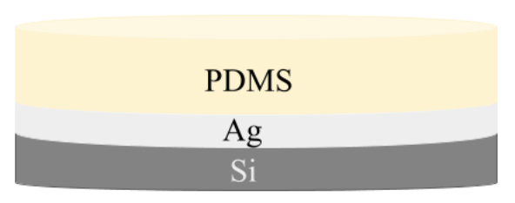
COMSOL: Modelling PDRCs.
At Hudgings lab, one of the simplest PDRCs has this structure:
I started modelling the PDRC layer by layer starting with Silica glass and working my way up to PDMS, each time plotting the reflectance versus the wavelength.

Slide 74
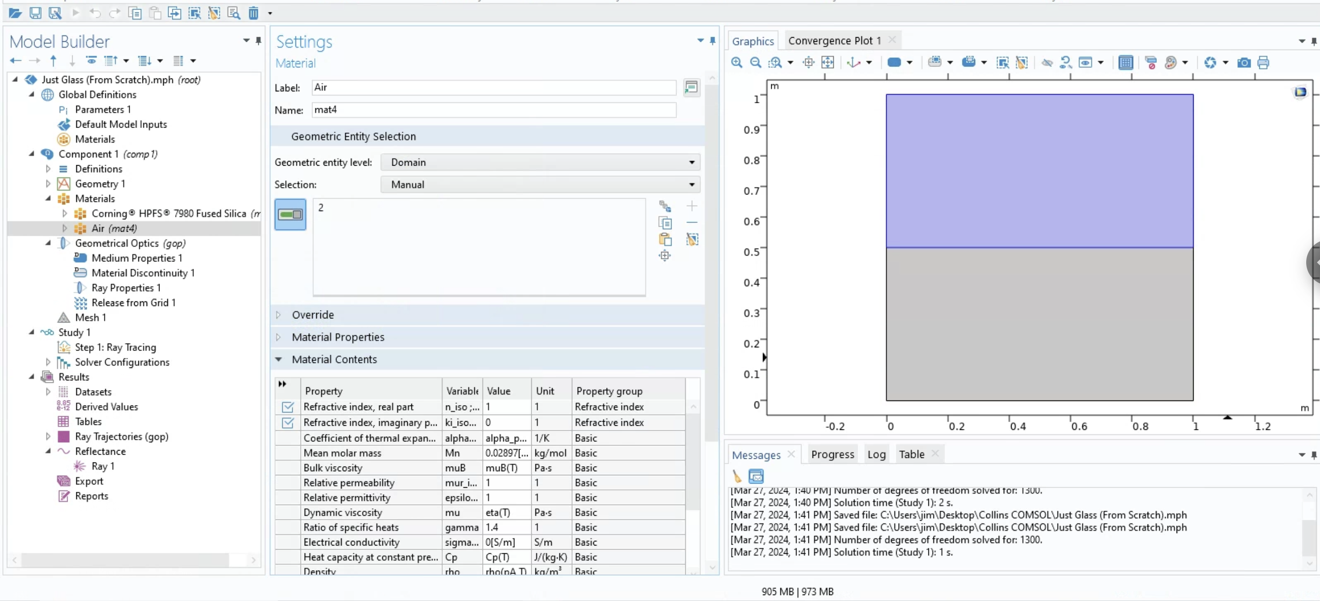
COMSOL: Modelling PDRCs (Just Glass).
Used Corning® HPFS® 7980 Fused Silica as the substrate

Slide 75
COMSOL: Modelling PDRCs (Just Glass).
For accurate simulations across a spectrum, it is essential to employ materials whose refractive indices are not fixed but change with wavelength.
This variability is addressed using an interpolation function.
This function relies on a data table correlating the refractive index with specific wavelengths over a range.
In COMSOL, such a function enables the simulation to adapt the material's refractive index for any given wavelength, reflecting the material's optical characteristics more realistically.

Slide 76
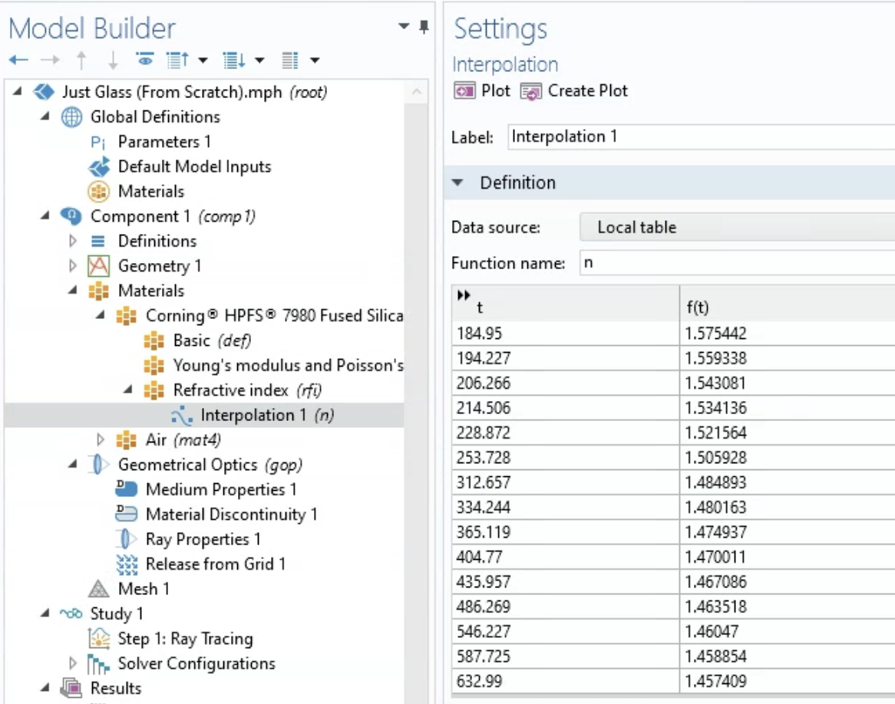
COMSOL: Modelling PDRCs (Just Glass).
Corning® HPFS® 7980 Fused Silica.
Interpolation Table: This is a dataset that contains pairs of values representing the wavelength (in nm) and the corresponding refractive index.
This table enables COMSOL to understand how the refractive index of this material changes with wavelength.
From the interpolation table, you can plot an interpolation function to visually check how the refractive indices varies with wavelength.

Slide 77
COMSOL: Modelling PDRCs (Just Glass).
Corning® HPFS® 7980 Fused Silica.
Interpolation Function: The function, n, uses the data from the interpolation table to create a continuous curve that approximates the refractive index for any wavelength within the range provided in the table. This is useful for simulations where the exact value of the refractive index is needed at wavelengths that may not be explicitly listed in the table.

Slide 78
COMSOL: Modelling PDRCs (Just Glass).
Corning® HPFS® 7980 Fused Silica.
The function, n, allows the COMSOL model to more accurately simulate how light interacts with the material across a range of wavelengths, which is particularly important in optical simulations where dispersive effects are significant.
Dispersion is crucial when designing lenses, antireflective coatings, and other optical components because it affects how different wavelengths of light are bent or reflected by a material.

Slide 79
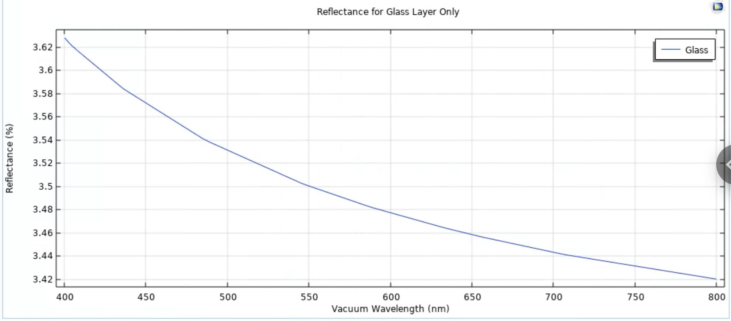
COMSOL: Modelling PDRCs (Just Glass).
Corning® HPFS® 7980 Fused Silica.
Zoomed-in version showcases dispersion.

Slide 80
COMSOL: Modelling PDRCs (Glass + Silver).
For this, I chose Ag (Silver) (Choi et al. 2020: n, k 1.23-6.99 um).
Here, I am basically choosing a predefined set of optical properties for silver based on a dataset provided by Choi et al. in 2020.
n = The real part of the complex refractive index
k (extinction coefficient) = The imaginary part of the complex refractive index representing how much the material absorbs light.
The n, k refers to the material’s complex refractive index over a range of wavelengths, specifically from 1230 nm to 6990 nm

Slide 81
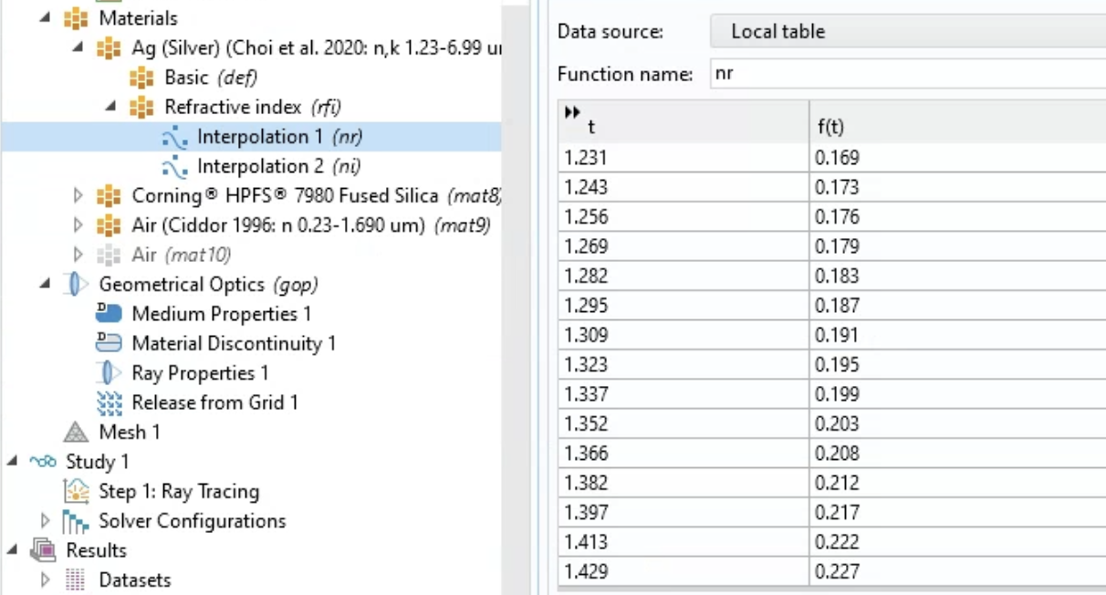
COMSOL: Modelling PDRCs (Glass + Silver).
Ag (Silver) (Choi et al. 2020: n, k 1.23-6.99 um) also has its own interpolation function for both the real and imaginary parts of the refractive index.

Slide 82

COMSOL: Modelling PDRCs (Glass + Silver).
A tale of unexpected results:

Slide 83
COMSOL: Modelling PDRCs (Glass + Silver).
A tale of unexpected results:
Reflectance Range: Typically, the reflectance of a material changes with wavelength due to the material's dispersion – the dependency of the refractive index on wavelength.

Slide 84
COMSOL: Modelling PDRCs (Glass + Silver).
A tale of unexpected results:
Material Properties: The constant 100% reflectance could imply that the material properties (refractive index and extinction coefficient) input into the simulation are not wavelength-dependent or are incorrectly defined.
Silver, known for its high reflectivity, still absorbs some light, which is not being accounted for in these results.

Slide 85
COMSOL: Modelling PDRCs (Glass + Silver).
A tale of unexpected results:
Modeling Error: This could be due to an error in the simulation setup, where the boundary conditions, material properties, or the physical model itself doesn't accurately reflect the real-world physics of the materials involved.

Slide 86

COMSOL: Modelling PDRCs (Glass + Silver).
What we expect the graph to look like:
For silver, particularly, one would expect high but not perfect reflectance in the visible range, gradually changing in the infrared range.

Slide 87
Some Challenges
Cost considerations:
The availability and cost of materials used in PDRC devices impact their commercial viability.
Equipment price: PDRCs often require large surface areas for effective cooling which can increase equipment costs.
Technical challenges:
Low cooling capacity: PDRC systems typically have lower cooling power compared to traditional AC methods.
Sophisticated material technology: Developing efficient radiators with suitable materials can be complex and requires specialized manufacturing techniques.
Durability: Ensuring the longevity and consistency of PDRC materials is crucial for sustained performance.
Environmental considerations: PDRC performance can vary significantly based on environmental conditions like location-specific factors like temperature, humidity, and solar exposure.

Slide 88
COMSOL: Modelling PDRCs (Glass + Silver + PDMS).
Same story as glass + silver: 100% reflectance over a multitude of wavelengths.

Slide 89
CONCLUSIONS

Slide 90
CONCLUSIONS
MATERIAL CONSTRAINTS
Overcoming material constraints:
- Faced challenges with accurately modelling the refractive indices of materials at various wavelengths.
Next steps: Incorporate more detailed dispersion models for materials from empirical data and/or literature.

Slide 91
CONCLUSIONS
SIMULATION CONSTRAINTS
Encountered limits within the COMSOL environment for modeling extremely thin layers (e.g., silver at 120 nm).
Plan to explore alternative simulation techniques within COMSOL to represent these layers accurately.

Slide 92
ACKNOWLEDGEMENT OF SUPPORT
I would like to thank:
Professor Hudgings for her support.
Professor James Higdon.

Slide 93
Appendix (2-layer Anti-Reflectance)
n (MgF₂) = 1.38
𝜆/4
n (CeF₃) = 1.63
𝜆/4
n_{s} (glass) = 1.5
0.5 m

Slide 94

Appendix (PDRCs at Hudgings Lab)
500 µm
120 nm
500 nm

Slide 95
Appendix (3-Layer Anti-Reflectance)
n (MgF₂) = 1.38
𝜆/4
n (ZrO₂) = 2.1
𝜆/2
n (CeF₃) = 1.63
𝜆/4
n_{s} (glass) = 1.5
0.5 m

